Slide 1
Locality-Driven Dynamic GPU Cache Bypassing
Weiguang Yang
2015-11-17

Slide 2
Menu
CBWT review
Locality-Driven Dynamic GPU Cache Bypassing
Background
GPU cache inefficiency
Decoupled L1D
Experiment
Design Space Exploration && Sensitivity to L1 D-cache Sizes &&
Sensitivity to Warp Scheduling Policies

Slide 3
CBWT review
Massively parallel, throughput-oriented
Cache contention / Cache pollution / Cache inefficiency
problem
solve
Warp throttling（CCWS）
Bypass（PDP）
Resource congestion
Chen, Xuhao, et al. "Adaptive Cache Management for Energy-Efficient GPU Computing." 2014 47th Annual IEEE/ACM International Symposium on Microarchitecture (MICRO) IEEE Computer Society, 2014:343-355.

Slide 4
Locality-Driven Dynamic GPU Cache Bypassing
Massively parallel, throughput-oriented
Cache contention / Cache pollution / Cache inefficiency
Bypass(Decoupled L1D )
PDP : protects hot cache lines
Decoupled L1D : only the data with high reuse and short reuse
distances are stored in the L1 D-cache
Li, C., Song, S. L., Dai, H., Sidelnik, A., Hari, S. K. S., & Zhou, H. (2015). Locality-Driven Dynamic GPU Cache Bypassing. Proceedings of the 29th ACM on International Conference on Supercomputing - ICS ’15 (Vol. 1, pp. 67-77).

Slide 5
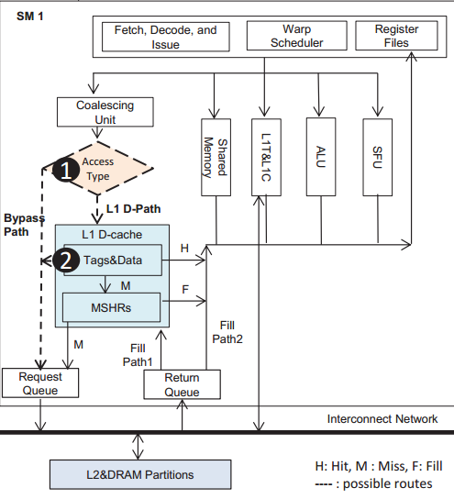
Background
Bypass path
L1D cache path

Slide 6
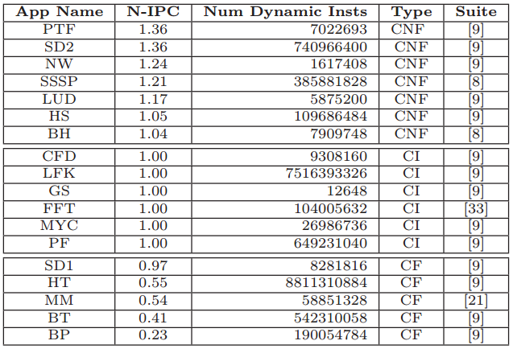
GPU cache inefficiency
Application categorization
Taken the Bypass Path
VS
all taking the L1 D-Path
Applications whose IPC improvement is greater
than 1 are classified as Cache Unfriendly (CNF)
Applications whose IPC values are not impacted
are classified as Cache Insensitive (CI)
IPC improvement is less than 1 are
Cache Friendly (CF):

Slide 7
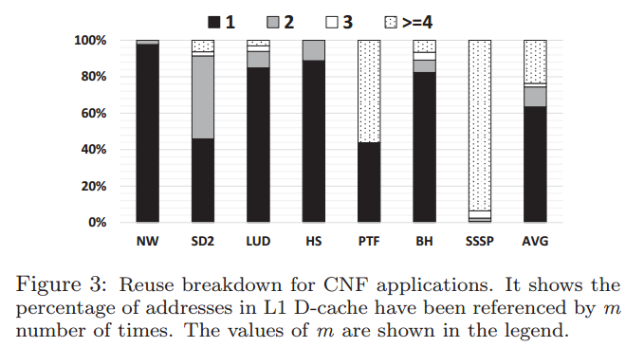
GPU cache inefficiency
memory requests for the majority of CNF applications are only reused less than three times.

Slide 8
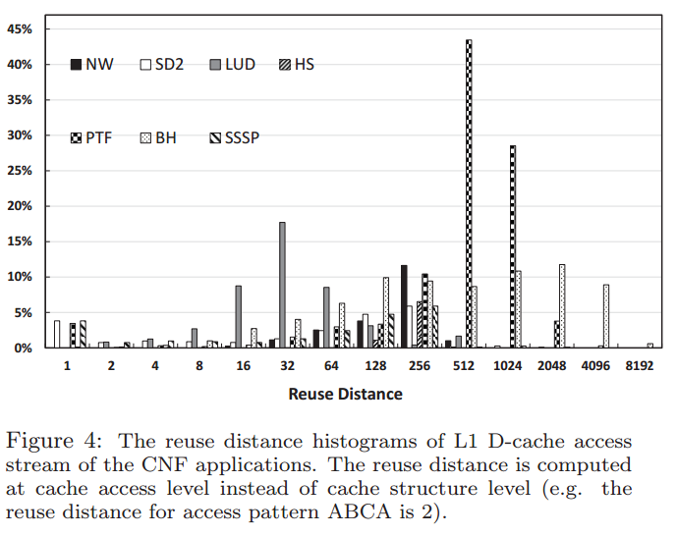
GPU cache inefficiency
the reuse distances are relatively high

Slide 9
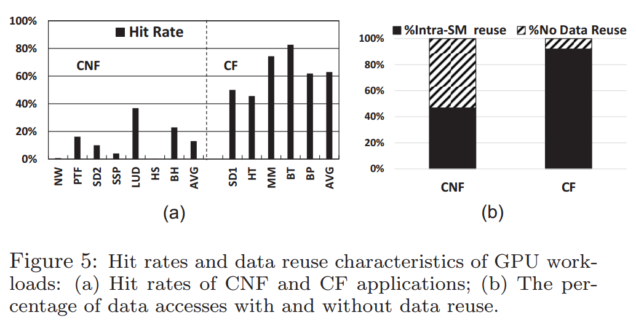
GPU cache inefficiency
Hit rate and data reuse, CNF VS CF

Slide 10
Decoupled L1D
Cache review
tag
index
byte in block
2b
3 bits
3 bits
Tag store
Data store
Address
V
tag
=?
MUX
byte in block
Hit?
Data
10

Slide 11
Decoupled L1D
Normal Cache
Decoupled L1D : Structure
Tag | Status | RC | Position
The RC field (6-bit) holds the reference frequency (reuse) accumulated for the address.
The Position field (2-bit) connects a tag store entry with a data line in the data store using a pointer to record the data line’s position
Tag | Status | LRU counter
Additional
Free Line, indicating how many free lines are available for use in the set

Slide 12
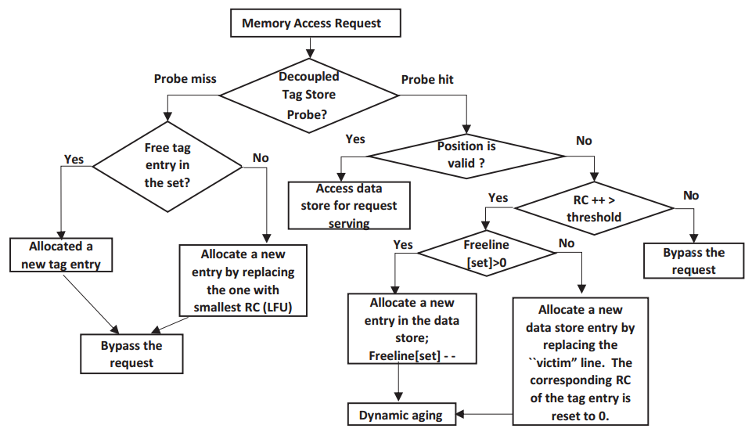
Decoupled L1D
Decoupled L1D : Operation
Tag | Status | RC | Position

Slide 13
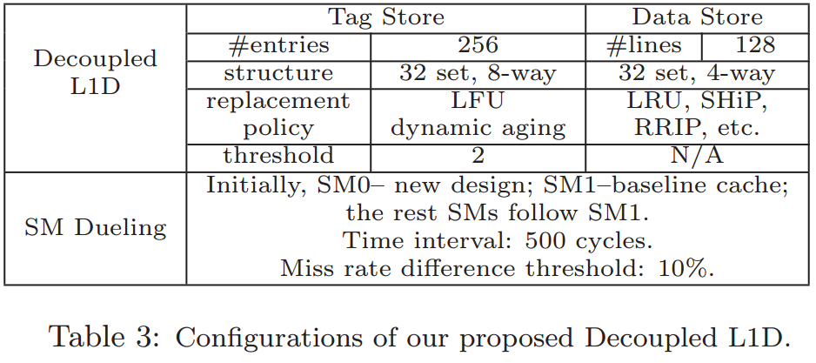
Decoupled L1D
Decoupled L1D : SM Dueling

Slide 14
Experiment 1
BL : Baseline Architecture
BALL : Bypass all memory accesses
Profiled-BYPASS : fine-grained L1 Bypass(software filter)
MRPB : when a pipeline stall, Bypass
PDP-Best : best static PDP-Bypass
Schemes

Slide 15
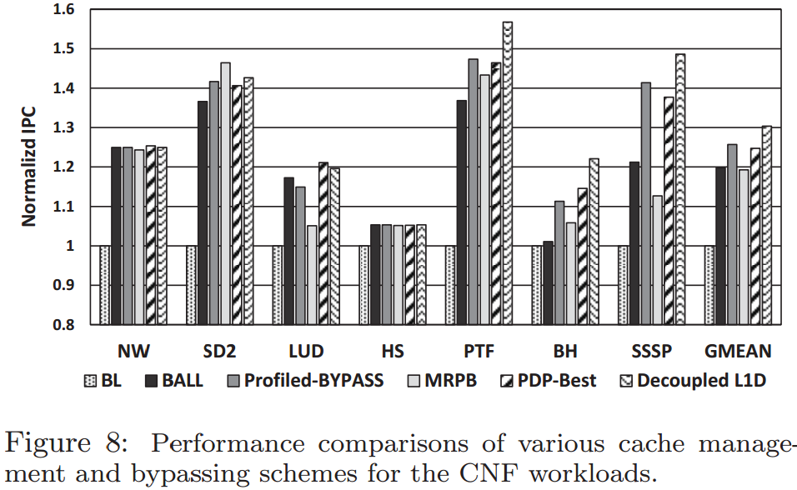
Experiment 1

Slide 16
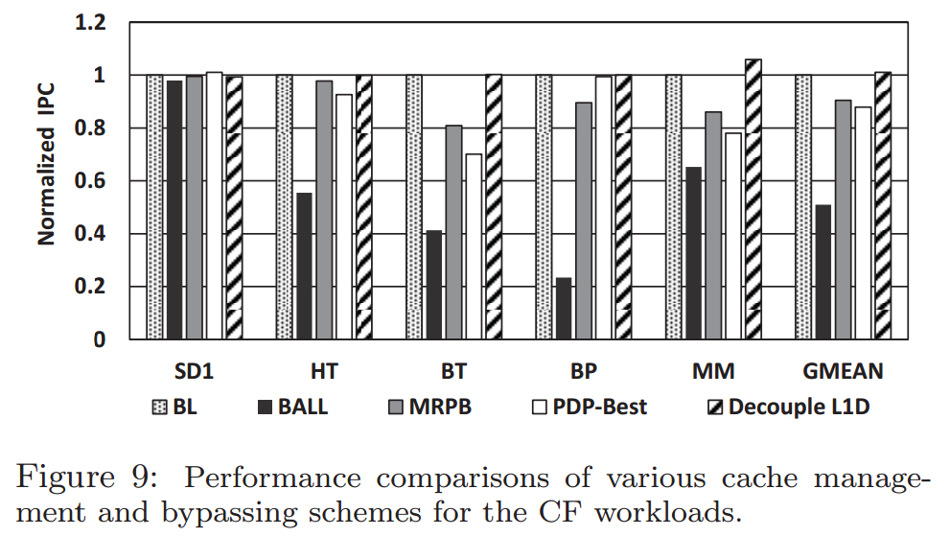
Experiment 2
robustness

Slide 17
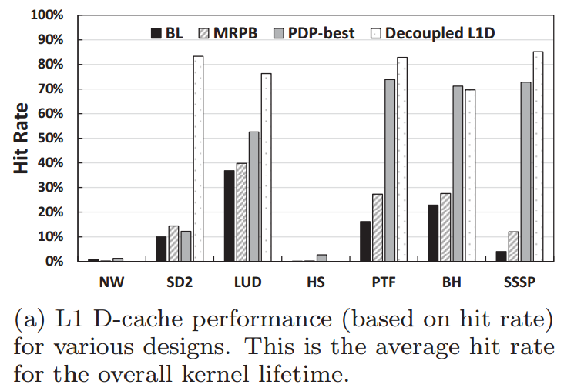
Experiment 3
L1D hit rate

Slide 18
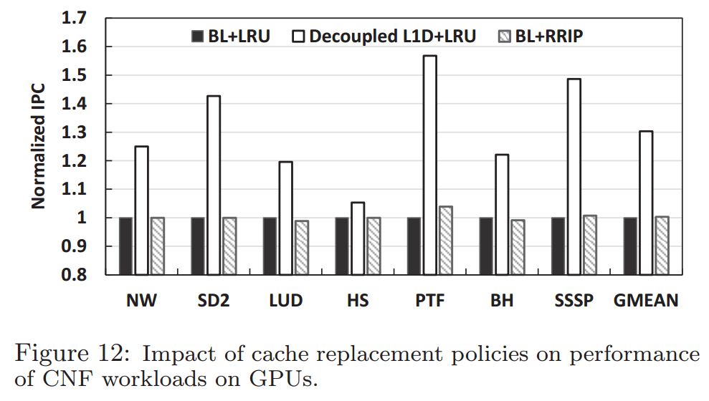
Experiment 4
Cache replacement

Slide 19
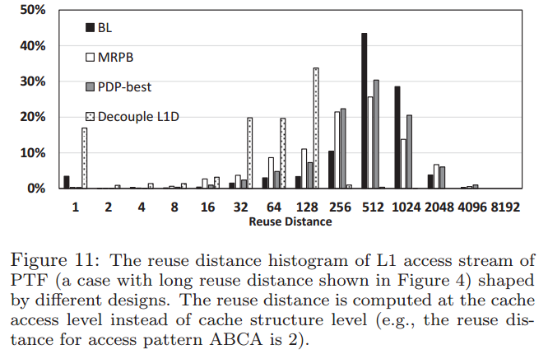
Experiment 5
Shaping Cache-Friendly Memory Access

Slide 20
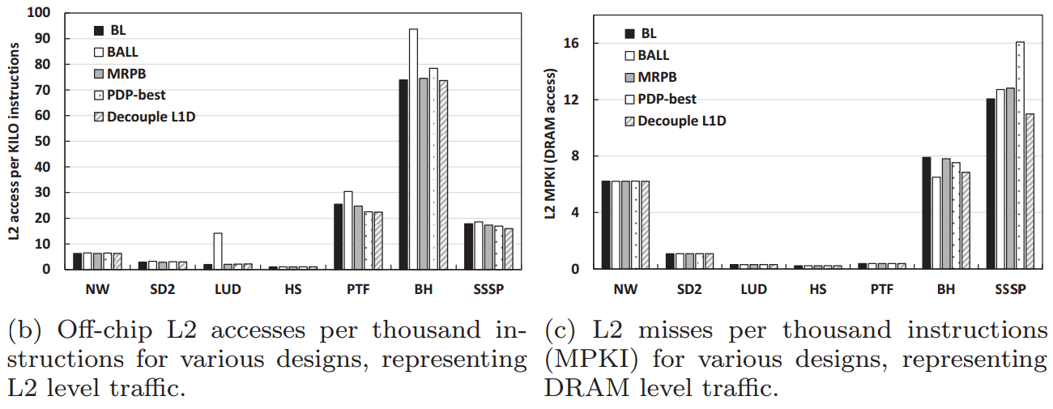
Experiment 6
Alleviating Various Contention

Slide 21
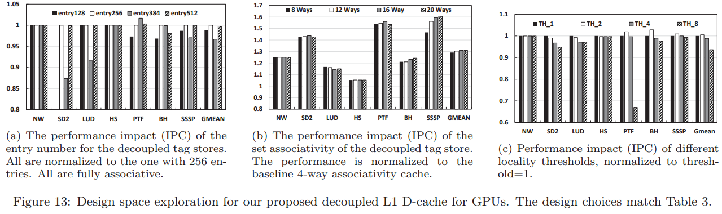
Design Space Exploration
entry number、associativity、 threshold

Slide 22
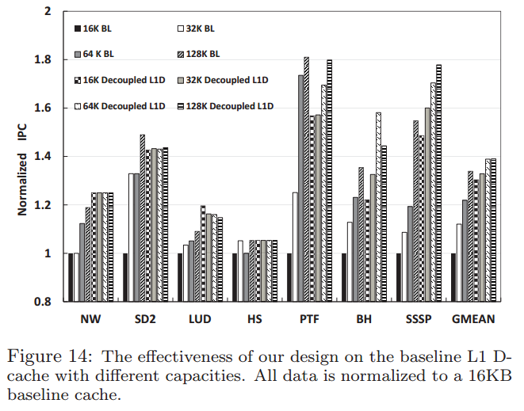
Sensitivity to L1 D-cache Sizes
performance improvements over the baseline, even at a larger cache size (128KB)

Slide 23
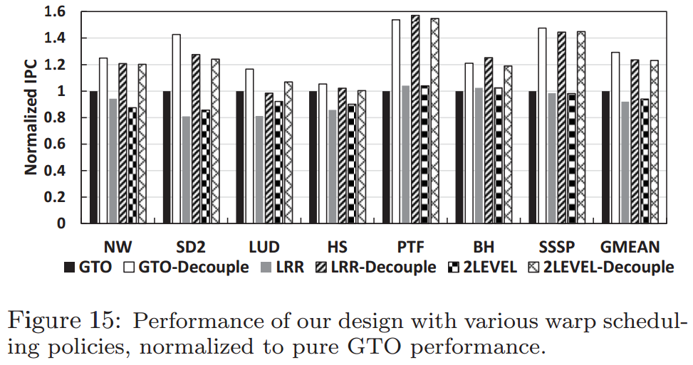
Sensitivity to Warp Scheduling Policies
achieve further performance gains with different warp scheduling policies

Slide 24
Thinking

Slide 25
Thanks

